Slide 1
Building a Calculator using Tkinter in Python
Name: Sukriti Singh Choudhary
Project- Nexthike
Date: 2nd Sept,2024

Slide 2
Introduction
Importance of GUI application in Python :-
Easy to use. Since data is represented by symbols, shapes and icons, users can easily recognize, classify and navigate options. ...
Easy to communicate. Visual representation of data is recognized faster than text.
Attractive. ...
Provides shortcuts. ...
Allows for multitasking.
Python Basics | Tkinter Basics
Understanding of variables, functions, and loops. | Basic knowledge of widgets like buttons, labels, and entry fields.

Slide 3
Importing and Setting Up Tkinter
import tkinter
from tkinter import *
root=Tk()
root.title("Basic Calculator")

Slide 4
Initialize the main window, Designing the Entry Field, functionality part, Main event loop
root=Tk() root.title("Basic Calculator") root.geometry("570x600+100+200") root.resizable(False,False) root.configure(bg="#2f4D49") | Label_result=Label(root,width=25, height=2, text="", font=("arial",30)) Label_result.pack()
answer = "" def show(value): global answer answer+=value Label_result.config(text=answer) | root.mainloop()

Slide 5
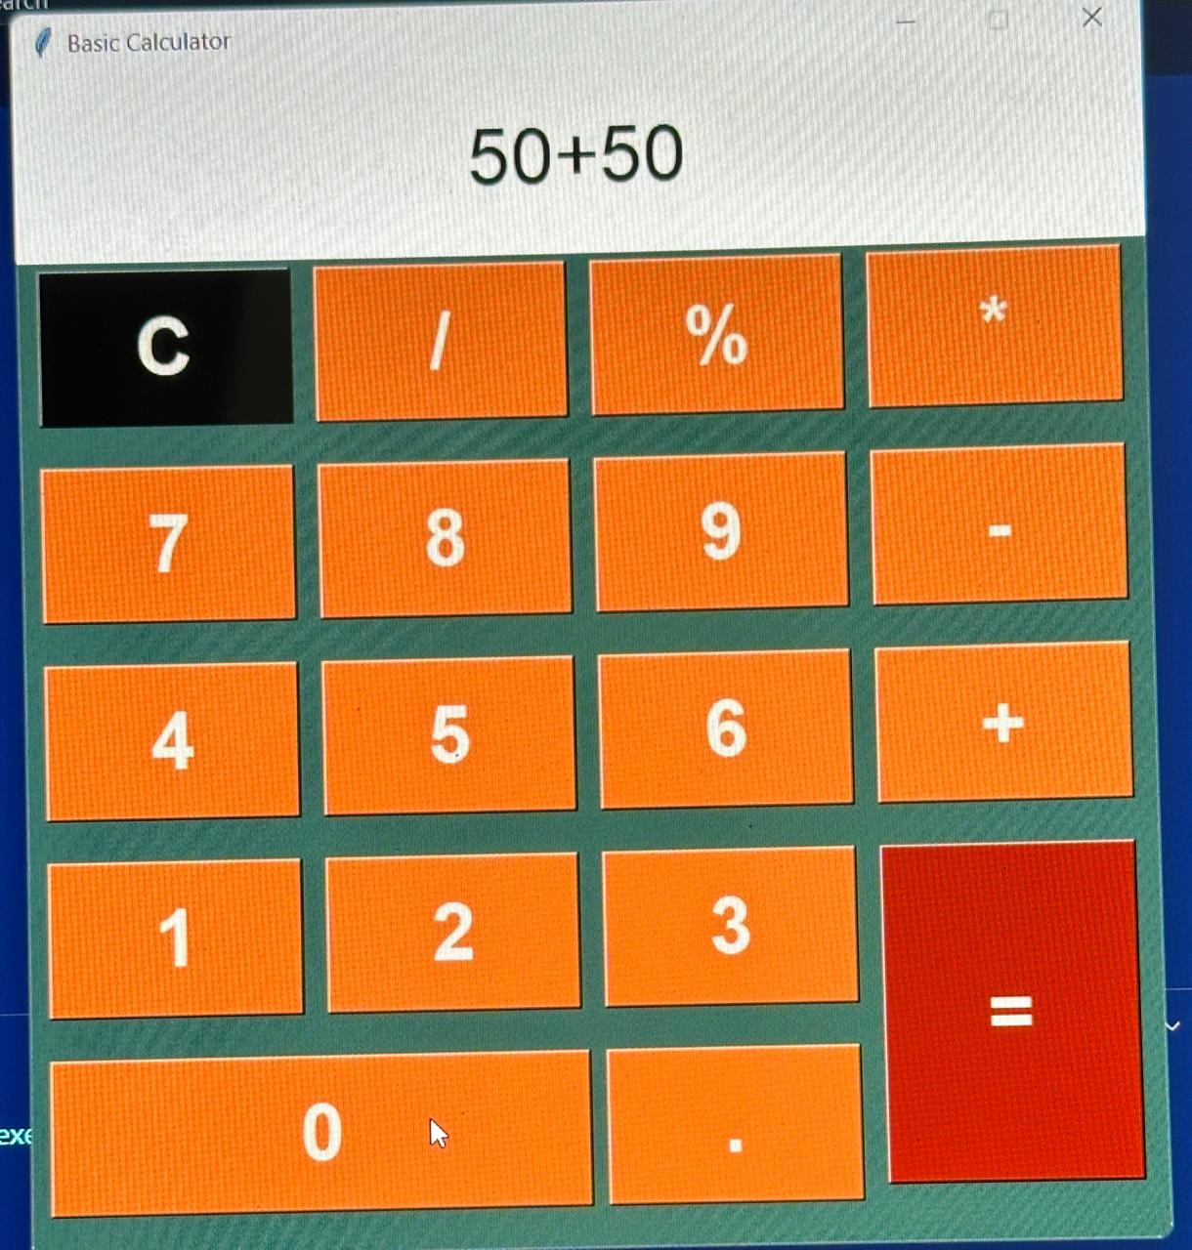
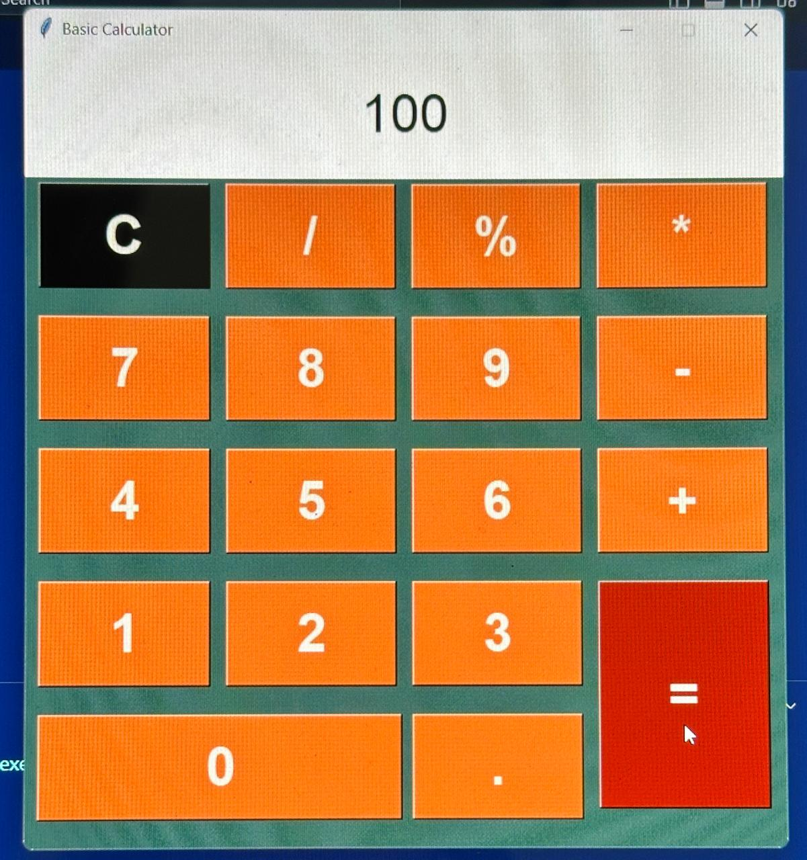
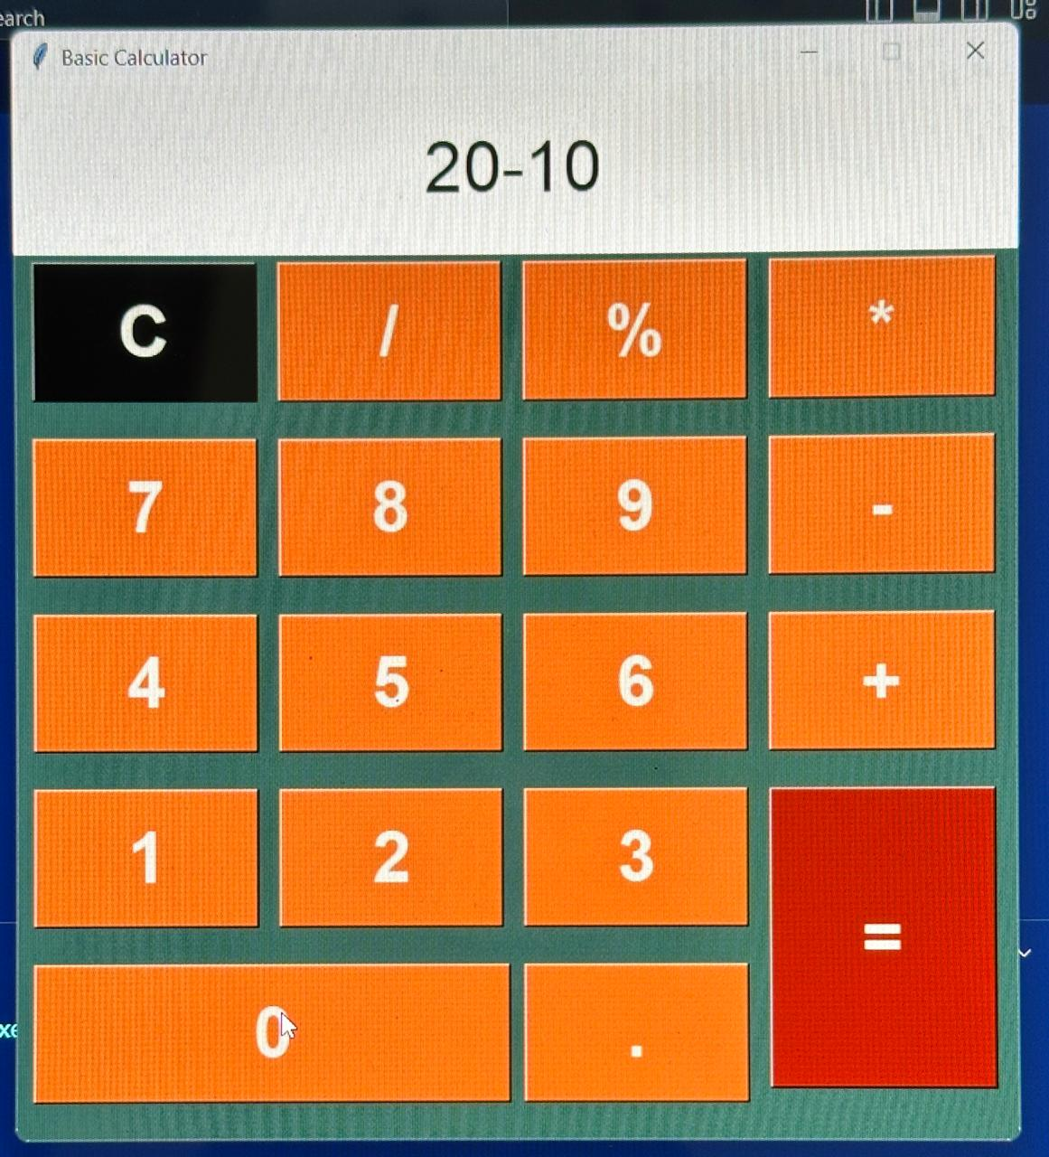
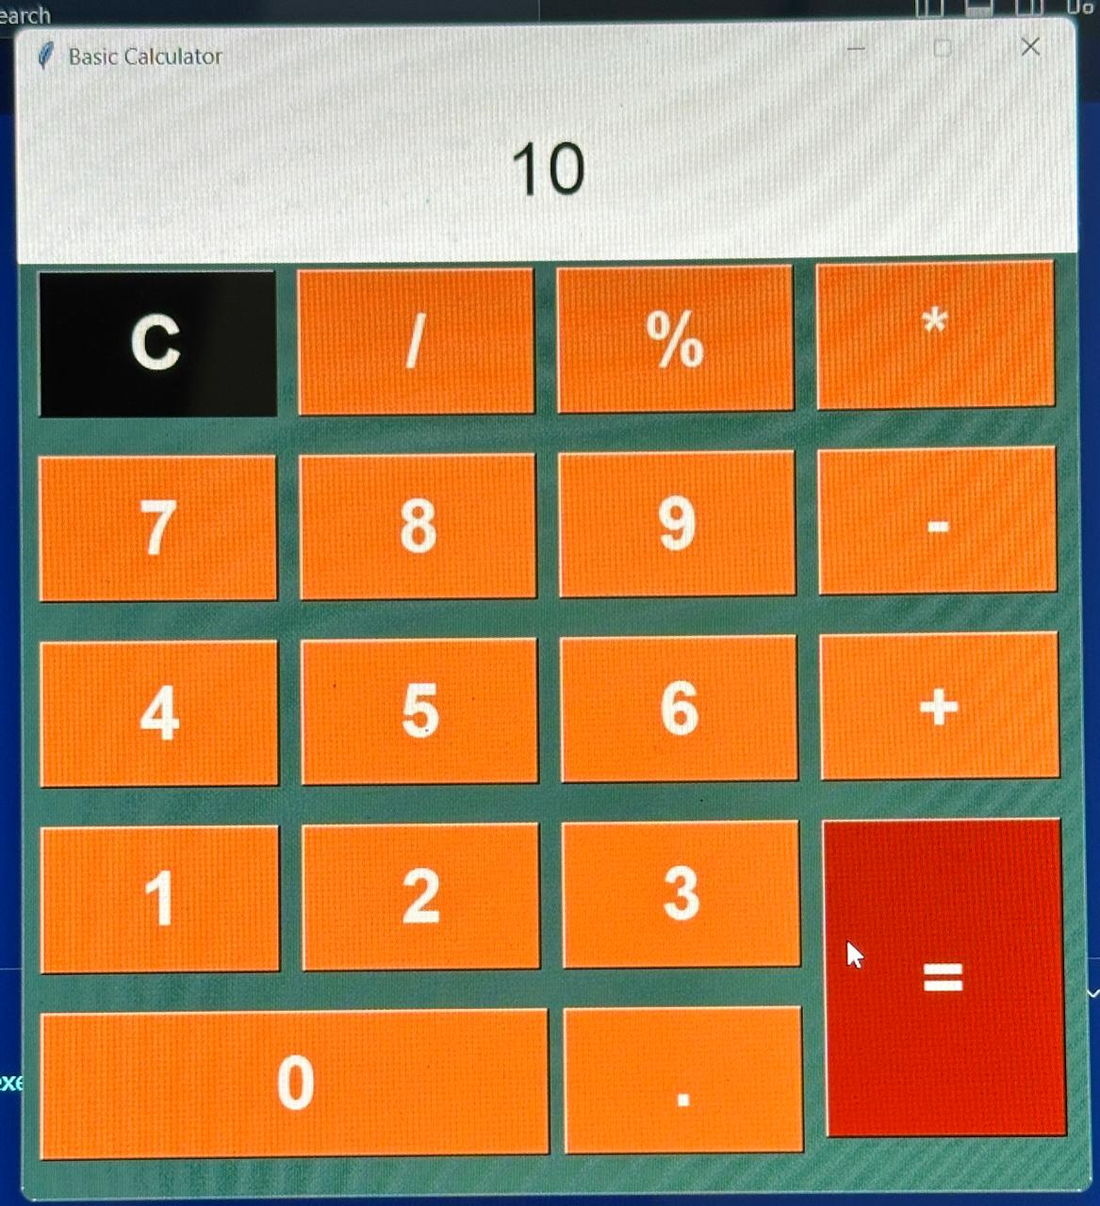
Sample Screenshot for outputs
For Addition
For Subtraction

Slide 6
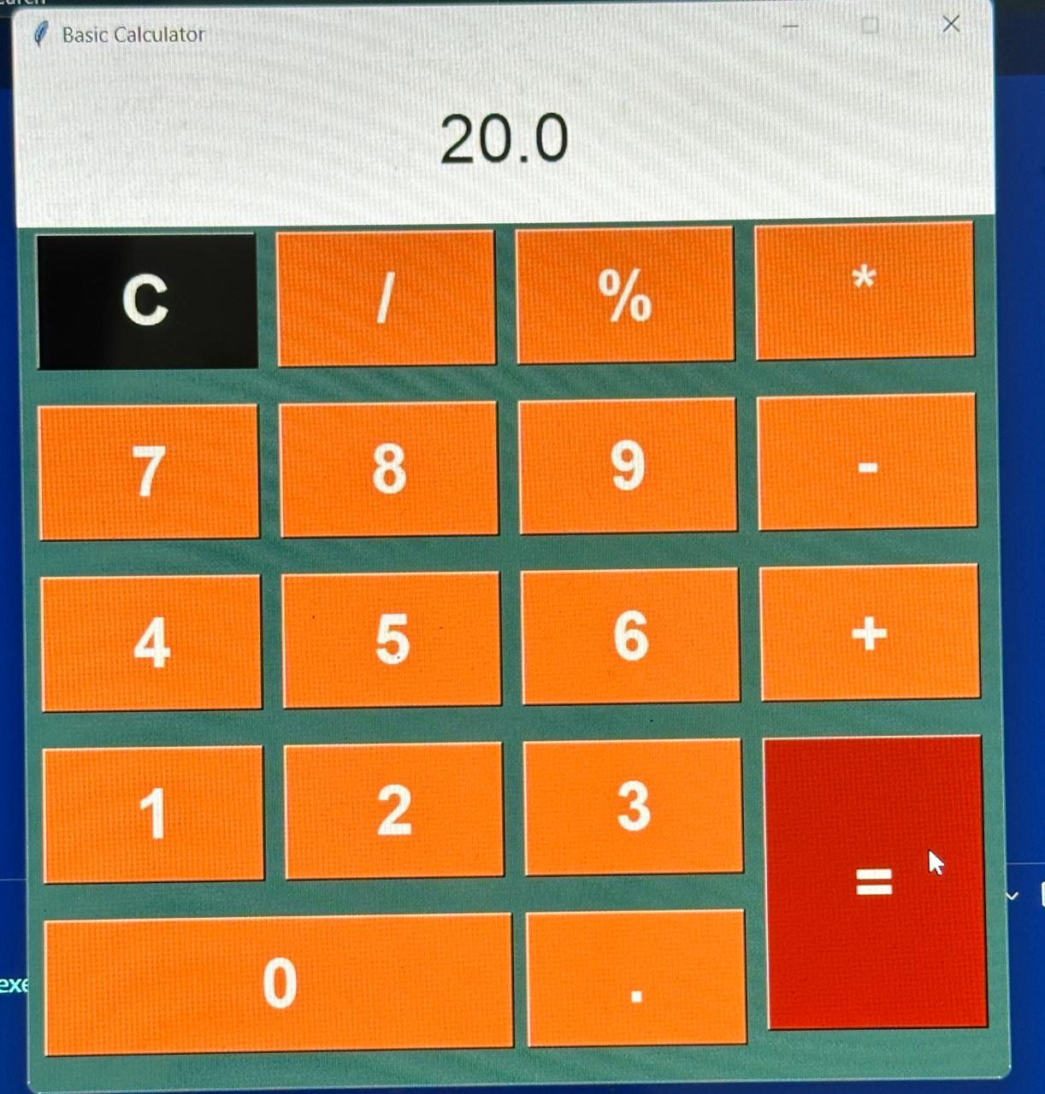
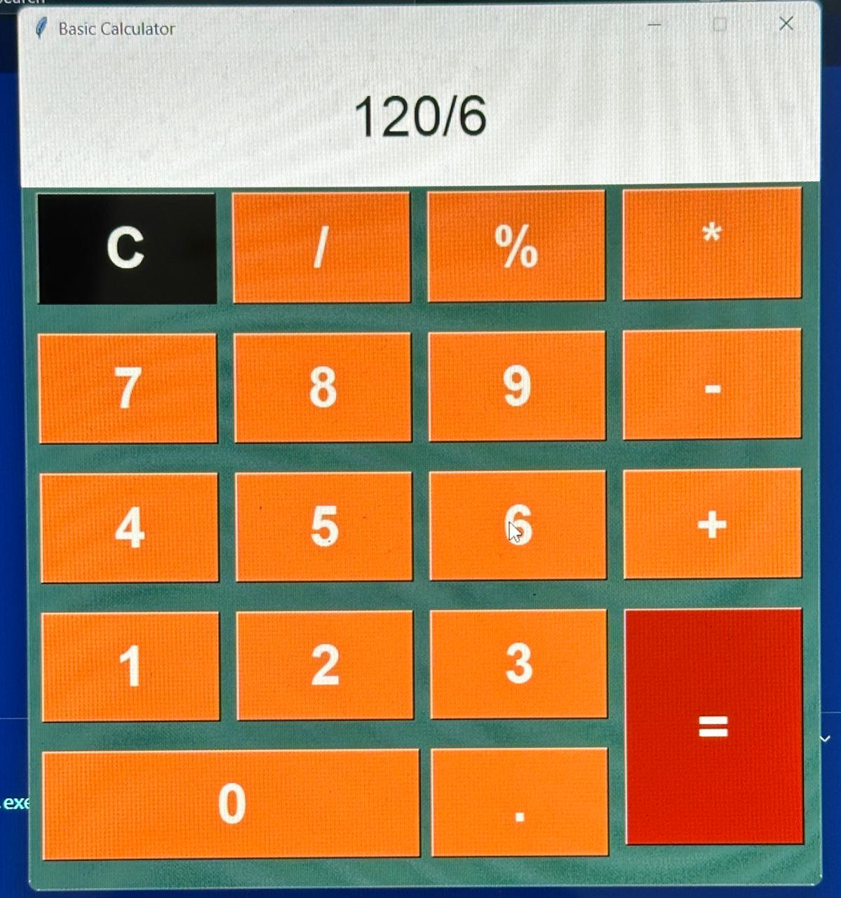
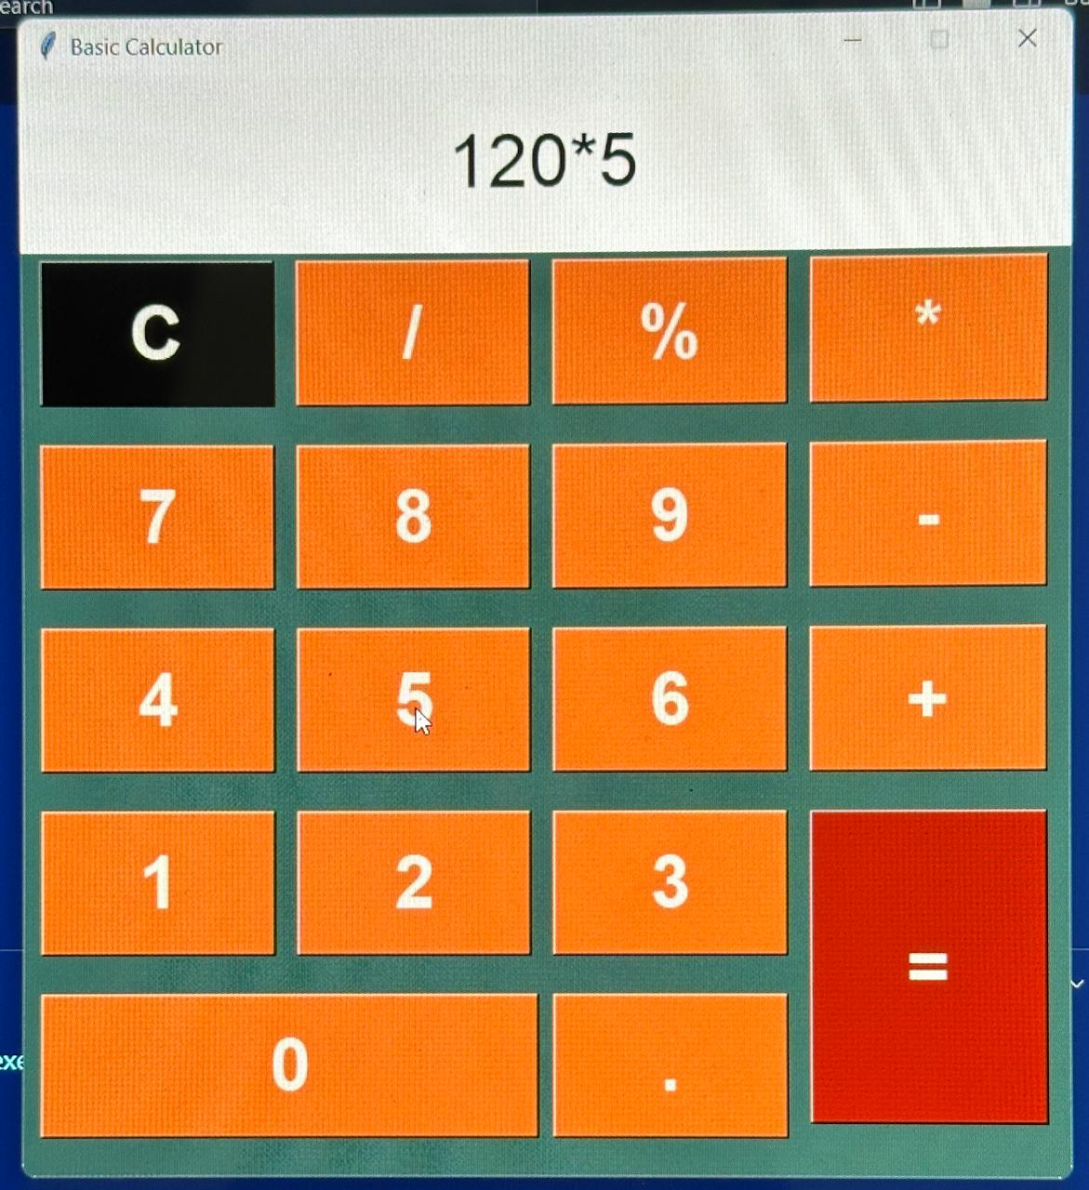
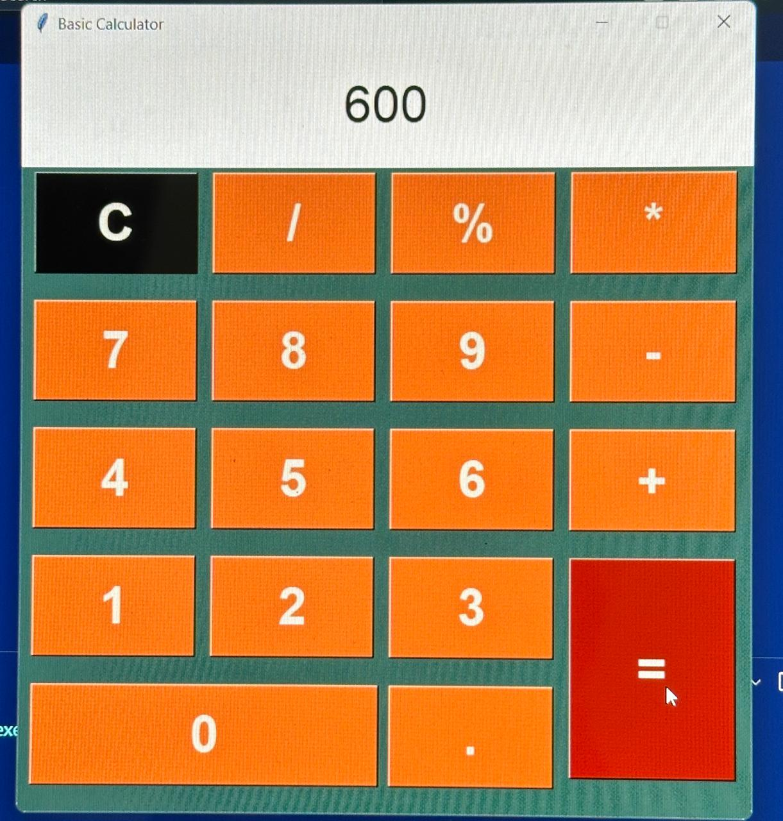
For division
For Multiplication

Slide 7
Conclusion
I have created a simple GUI calculator using Tkinter in Python.
Importance of GUI in Python applications.
This project introduces you to basic GUI programming in Python.
Explore adding more features or creating other GUI applications in future.
The calculator performs basic arithmetic operations: addition, subtraction, multiplication, and division.
We covered key concepts like setting up a GUI window, creating buttons, handling user input, and performing calculations.

Slide 8
Thank You

